Slide 1
Introduction to Constraints
Constraints:
Are rules or restrictions that guide database inserts, updates, and deletions
Keep invalid or erroneous data out of the database
Can be enforced by:
  Declaring integrity constraints
  Writing a database trigger
  Programming constraints into an application
The focus of this chapter
Oracle9i Database Administrator: Implementation and Administration

Slide 2
Introduction to Constraints
Advantages of integrity constraints:
Simple to create and maintain
Always enforced, regardless of tool or application that updates table data
Performs faster than other methods
Oracle9i Database Administrator: Implementation and Administration

Slide 3
Types of Constraints
Types of constraints:
PRIMARY KEY: enforces primary key
UNIQUE: prevents duplicate values
FOREIGN KEY: enforces parent/child relationships
NOT NULL: prevents storage of null values
CHECK: validates values
Oracle9i Database Administrator: Implementation and Administration

Slide 4
Relational Integrity Constraints
Constraints are conditions that must hold on all valid relation instances. There are three main types of constraints:
  Key constraints
  Entity integrity constraints
  Referential integrity constraints
Oracle9i Database Administrator: Implementation and Administration

Slide 5
Key Constraints…2
  Example: The CAR relation schema:
  CAR(State, Reg#, SerialNo, Make, Model, Year)
  has two keys
  Key1 = {State, Reg#},
  Key2 = {SerialNo}.
  {SerialNo, Make} is a superkey but not a key.
If a relation has several candidate keys, one is chosen arbitrarily to be the primary key. The primary key attributes are underlined.
Oracle9i Database Administrator: Implementation and Administration

Slide 6
Entity Integrity:
The primary key attributes PK of each relation schema R cannot have null values in any tuple of r(R). This is because primary key values are used to identify the individual tuples.
Oracle9i Database Administrator: Implementation and Administration

Slide 7
Referential Integrity
A constraint involving two relations (the previous constraints involve a single relation).
Used to specify a relationship among tuples in two relations: the referencing relation and the referenced relation.
Tuples in the referencing relation R₁ have attributes FK (called foreign key attributes) that reference the primary key attributes PK of the referenced relation R₂.
Oracle9i Database Administrator: Implementation and Administration

Slide 8
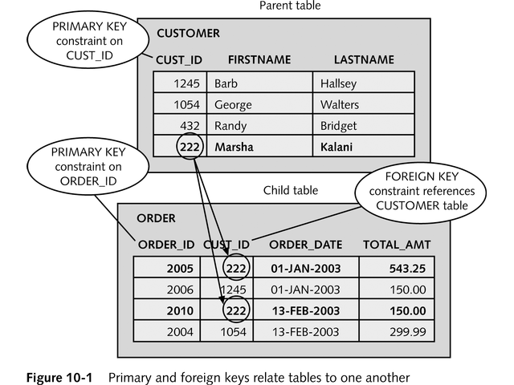
Types of Constraints
Example of PRIMARY KEY and FOREIGN KEY constraints
Oracle9i Database Administrator: Implementation and Administration

Slide 9
How to Create and Maintain Integrity Constraints
Two methods for creating integrity constraints:
  Code them in the CREATE TABLE command
  Add them later with the ALTER TABLE command
Oracle9i Database Administrator: Implementation and Administration

Slide 10
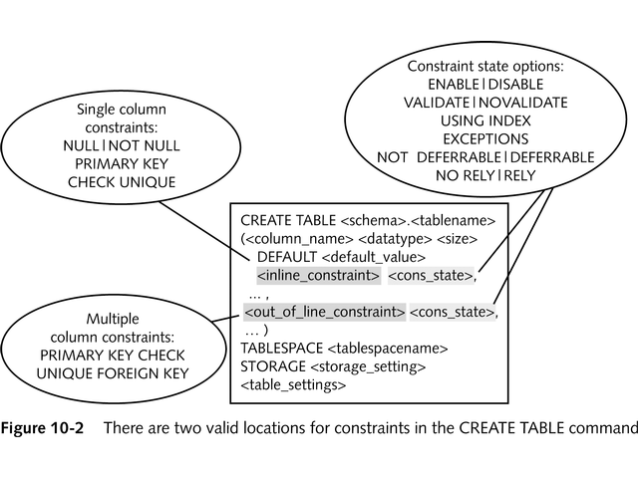
Creating Constraints Using the CREATE TABLE Command
Syntax of the CREATE TABLE command:
Oracle9i Database Administrator: Implementation and Administration

Slide 11
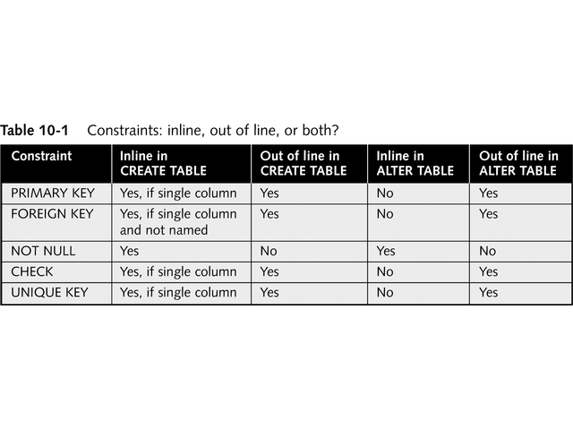
Creating Constraints Using the CREATE TABLE Command
Location for constraint in the command:
Inline when related to only one column and created using CREATE TABLE
Out of line when related two or more columns, or
when created using ALTER TABLE command
(except NOT NULL, which is always defined inline)
Oracle9i Database Administrator: Implementation and Administration

Slide 12
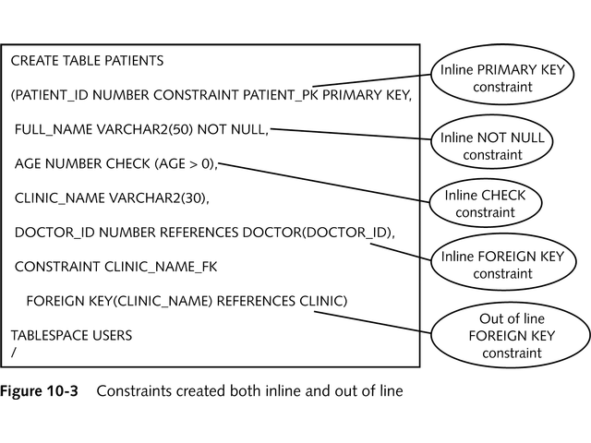
Creating Constraints Using the CREATE TABLE Command
Example of constraint in CREATE TABLE:
Oracle9i Database Administrator: Implementation and Administration

Slide 13
Creating Constraints Using the CREATE TABLE Command
Constraint states:
ENABLE / DISABLE
VALIDATE / NOVALIDATE
INITIALLY IMMEDIATE / INITIALLY DEFERRED
DEFERRABLE / NOT DEFERRABLE
Oracle9i Database Administrator: Implementation and Administration

Slide 14
Creating Constraints Using the ALTER TABLE Command
Syntax of ALTER TABLE varies according to what you are planning to do
Three forms for:
  Changing NULL / NOT NULL
  Adding constraints
  Changing existing constraints
Oracle9i Database Administrator: Implementation and Administration

Slide 15
Adding or Removing NOT NULL on an Existing Column
Syntax:
  ALTER TABLE <tablename>
  MODIFY (<columnname> NULL|NOT NULL);
To add a NOT NULL constraint successfully, all rows in the table must contain values for the column
Oracle9i Database Administrator: Implementation and Administration

Slide 16
Adding a New Constraint to an Existing Table
Syntax:
  ALTER TABLE <tablename>
  ADD CONSTRAINT <constraintname>
  PRIMARY KEY (<colname>, ...) |
  FOREIGN KEY (<colname>, ...)
  REFERENCES <schema>.<tablename> (<colname>, ...) |
  UNIQUE (<colname>, ...) |
  CHECK (<colname>, ...) (<check_list>);
Use out of line constraint format for all types of constraints
Omit "CONSTRAINT <constraintname>" to create a constraint that is named by the system
Oracle9i Database Administrator: Implementation and Administration

Slide 17
Changing or Removing a Constraint
Syntax:
  ALTER TABLE <tablename>
  RENAME CONSTRAINT <oldname> TO <newname>|
  MODIFY CONSTRAINT <constraintname>
  <constraint_state> <constraint_state> ...;
The only changes allowed are:
  Renaming the constraint
  Changing the constraint state
Oracle9i Database Administrator: Implementation and Administration

Slide 18
Changing or Removing a Constraint
Examples:
Renaming a constraint:
  ALTER TABLE CUSTOMER
  RENAME CONSTRAINT CUST_FK TO CUST_ORDER_FK;
Changing a constraint's state:
  ALTER TABLE CUSTOMER
  ENABLE CONSTRAINT CUST_UNQ
  EXCEPTIONS TO BADCUSTOMERS
  USING CUST_UNQ_INDEX;
Oracle9i Database Administrator: Implementation and Administration

Slide 19
Practical Examples of Working With Constraints
Examples of each type of constraint:
  Adding/removing NOT NULL
  Adding/modifying PRIMARY KEY
  Adding/modifying UNIQUE constraint
  Adding/modifying FOREIGN KEY
  Adding/modifying CHECK constraint
Oracle9i Database Administrator: Implementation and Administration

Slide 20
Adding or Removing a NOT NULL Constraint
Add NOT NULL in CREATE TABLE:
  CREATE TABLE CH10DOGSHOW
  (DOGSHOWID NUMBER NOT NULL,
  SHOW_NAME VARCHAR2(40) NOT NULL,
  DATE_ADDED DATE DEFAULT SYSDATE NOT NULL);
Remove NOT NULL:
  ALTER TABLE CH10DOGSHOW
  MODIFY (SHOW_NAME NULL);
Add NOT NULL with ALTER TABLE:
  ALTER TABLE CH10DOGSHOW
  MODIFY (SHOW_NAME NOT NULL);
Oracle9i Database Administrator: Implementation and Administration

Slide 21
Adding and Modifying a PRIMARY KEY Constraint
Add inline PRIMARY KEY in CREATE TABLE:
  CREATE TABLE CH10DOGOWNER
  (OWNER_ID NUMBER CONSTRAINT CH10_PK PRIMARY KEY,
  OWNER_NAME VARCHAR2(50),
  MEMBER_OF_AKC CHAR(3) DEFAULT 'NO',
  YEARS_EXPERIENCE NUMBER(2,0));
Rename PRIMARY KEY:
  ALTER TABLE CH10DOGOWNER
  RENAME CONSTRAINT CH10_PK TO CH10_DOG_OWNER_PK;
Oracle9i Database Administrator: Implementation and Administration

Slide 22
Adding and Modifying a PRIMARY KEY Constraint
Drop PRIMARY KEY:
  ALTER TABLE CH10DOGOWNER
  DROP CONSTRAINT CH10_DOG_OWNER_PK;
Add PRIMARY KEY with ALTER TABLE:
  ALTER TABLE CH10DOGOWNER
  ADD CONSTRAINT CH10_DOG_OWNER_PK
  PRIMARY KEY (OWNER_ID)
  DISABLE;
Change state of PRIMARY KEY:
  ALTER TABLE CH10DOGOWNER
  MODIFY CONSTRAINT CH10_DOG_OWNER_PK ENABLE;
Oracle9i Database Administrator: Implementation and Administration

Slide 23
Adding and Modifying a UNIQUE Constraint
Add inline UNIQUE constraint in CREATE TABLE:
  CREATE TABLE CH10WORLD
  (COUNTRY VARCHAR2(10),
  PERSON_ID NUMBER,
  US_TAX_ID NUMBER(10) CONSTRAINT US_TAX_UNIQUE UNIQUE,
  FIRST_NAME VARCHAR2(10),
  LAST_NAME VARCHAR2(20),
  CONSTRAINT CH10WORLD_PK
  PRIMARY KEY (COUNTRY, PERSON_ID));
Change UNIQUE constraint state:
  ALTER TABLE CH10WORLD
  MODIFY CONSTRAINT US_TAX_UNIQUE DISABLE;
Oracle9i Database Administrator: Implementation and Administration

Slide 24
Adding and Modifying a UNIQUE Constraint
In preparation for the EXCEPTIONS INTO <table> clause:
  Create an EXCEPTIONS table
  Use predefined script: utlexcpt.sql
Change UNIQUE constraint state:
  ALTER TABLE CH10WORLD
  MODIFY CONSTRAINT US_TAX_UNIQUE ENABLE VALIDATE
  EXCEPTIONS INTO EXCEPTIONS;
Oracle9i Database Administrator: Implementation and Administration

Slide 25
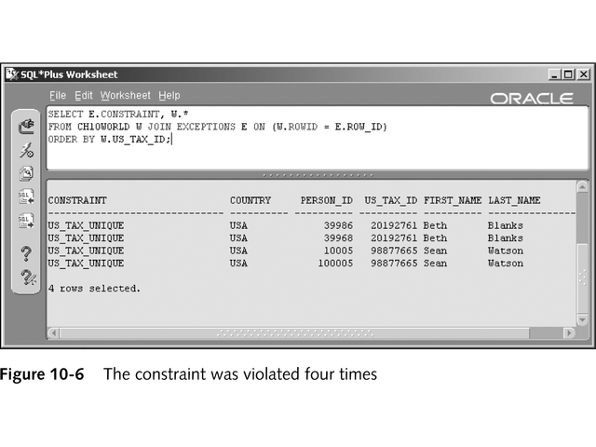
Adding and Modifying a UNIQUE Constraint
Query joins table with EXCEPTIONS table to see invalid rows:
Oracle9i Database Administrator: Implementation and Administration

Slide 26
Working With a FOREIGN KEY Constraint
Create out of line FOREIGN KEY in CREATE TABLE:
  CREATE TABLE CH10DOG
  (DOG_ID NUMBER,
  OWNER_ID NUMBER(10) ,
  DOG_NAME VARCHAR2(20),
  BIRTH_DATE DATE,
  CONSTRAINT CH10DOGOWNER_FK
  FOREIGN KEY (OWNER_ID) REFERENCES CH10DOGOWNER
  DEFERRABLE INITIALLY IMMEDIATE);
Oracle9i Database Administrator: Implementation and Administration

Slide 27
Working With a FOREIGN KEY Constraint
Defer specific constraints during session:
  SET CONSTRAINTS DOG_FK, SHOW_NAME_FK DEFERRED;
Defer all deferrable constraints during session:
  SET CONSTRAINTS ALL DEFERRED;
Reset all deferrable constraints during session:
  SET CONSTRAINTS ALL IMMEDIATE;
Oracle9i Database Administrator: Implementation and Administration

Slide 28
Working With a FOREIGN KEY Constraint
Drop PRIMARY KEY constraint and FOREIGN KEY constraint (cascading):
  ALTER TABLE CH10DOGOWNER
  DROP CONSTRAINT CH10_DOG_OWNER_PK
  CASCADE;
Oracle9i Database Administrator: Implementation and Administration

Slide 29
Creating and Changing a CHECK Constraint
Create CHECK constraint in existing table:
  ALTER TABLE CH10DOGOWNER ADD CONSTRAINT AKC_YN
  CHECK (MEMBER_OF_AKC IN ('YES','NO'));
Create disabled CHECK constraint:
  ALTER TABLE CH10DOGSHOW ADD CONSTRAINT ALL_CAPS
  CHECK (SHOW_NAME = UPPER(SHOW_NAME)) DISABLE;
Oracle9i Database Administrator: Implementation and Administration

Slide 30
Creating and Changing a CHECK Constraint
Enable CHECK constraint:
  ALTER TABLE CH10DOGSHOW MODIFY CONSTRAINT ALL_CAPS ENABLE;
Create CHECK constraint that compares two columns:
  ALTER TABLE CH10WORLD ADD
  CONSTRAINT CHK_NAMES
  CHECK ((FIRST_NAME IS NOT NULL OR
  LAST_NAME IS NOT NULL)
  AND(FIRST_NAME <> LAST_NAME));
Oracle9i Database Administrator: Implementation and Administration

Slide 31
Creating and Changing a CHECK Constraint
More points about CHECK constraint:
  Can only refer to data in a single row
  Cannot contain a query
  Cannot refer to another table
  Cannot use pseudocolumns, such as SYSDATE or USER
Oracle9i Database Administrator: Implementation and Administration

Slide 32
Data Dictionary Information on Constraints
ALL_CONSTRAINTS:
  Lists all constraints
  Has USER_ and DBA_ counterpart views
ALL_COL_CONSTRAINTS
  Lists columns referenced in constraints
Oracle9i Database Administrator: Implementation and Administration

Slide 33
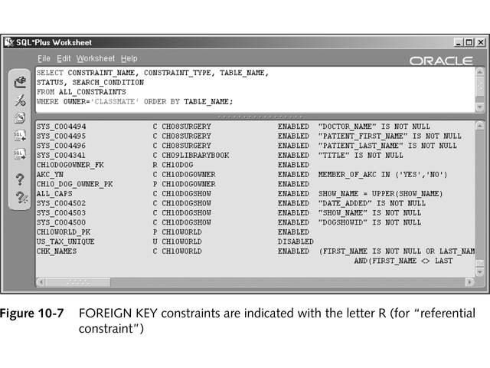
Data Dictionary Information on Constraints
Example of querying ALL_CONSTRAINTS:
Oracle9i Database Administrator: Implementation and Administration

Slide 34
Chapter Summary
Integrity constraints can be enforced using declared constraints, triggers, or application programming
A FOREIGN KEY constraint identifies a parent/child relationship between two tables and is defined on the child table
Constraints can be created with the CREATE TABLE and the ALTER TABLE commands
Use the ALTER TABLE statement to rename, drop, or change the state of a constraint
Oracle9i Database Administrator: Implementation and Administration

Slide 35
Chapter Summary
To remove the NOT NULL constraint, use ALTER TABLE MODIFY (column...) statement
When a PRIMARY KEY constraint is created (and not disabled), a unique index is created to help enforce the constraint
Use the NOVALIDATE constraint state when you do not want existing rows to be checked for compliance with a constraint
The default states of a constraint are ENABLE, VALIDATE, INITIALLY IMMEDIATE,
NOT DEFERRABLE, and NORELY
Oracle9i Database Administrator: Implementation and Administration

Slide 36
Chapter Summary
ENABLE … EXCEPTIONS into … can be used after creating a table (usually called EXCEPTIONS) to hold the rowid of rows that violate a constraint
ON DELETE CASCADE and ON DELETE SET NULL define the behavior of the database when a parent row is deleted
The CHECK constraint can look for a specified list of values or other simple expressions
Oracle9i Database Administrator: Implementation and Administration

